Slide 1

Considerations for On-Premise data & PowerBI
Craig Porteous
BI Dev Ops
CraigPorteous.com
@cporteous
Glasgow SQL User Group
21st Feb 2017

Slide 2

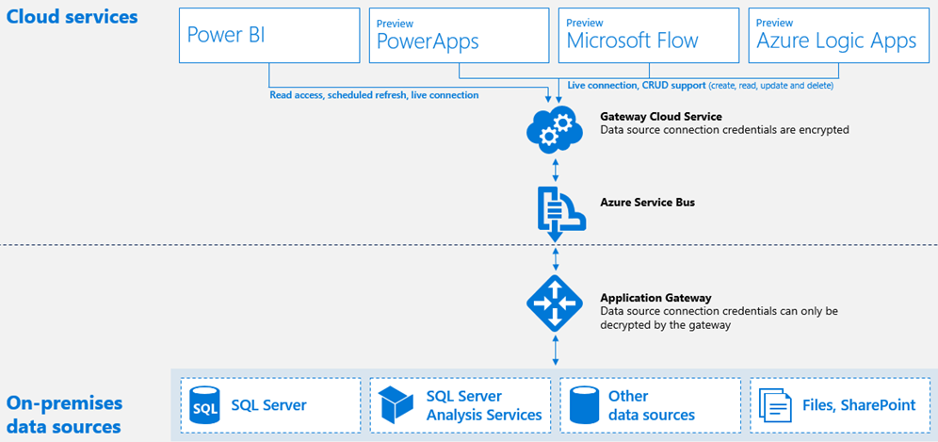
Overview
Allows secure access to On-premise data (or other cloud services) as data sources in PowerBI
2 flavours of Gateway
On Premise (IT managed) – Live data possible
Personal (User managed)
Live Query to Analysis Services
Multidimensional & Tabular
Scheduled refreshes of data from SQL & other sources
Overview provides a wealth of info:
https://powerbi.microsoft.com/en-us/documentation/powerbi-gateway-onprem/

Slide 3
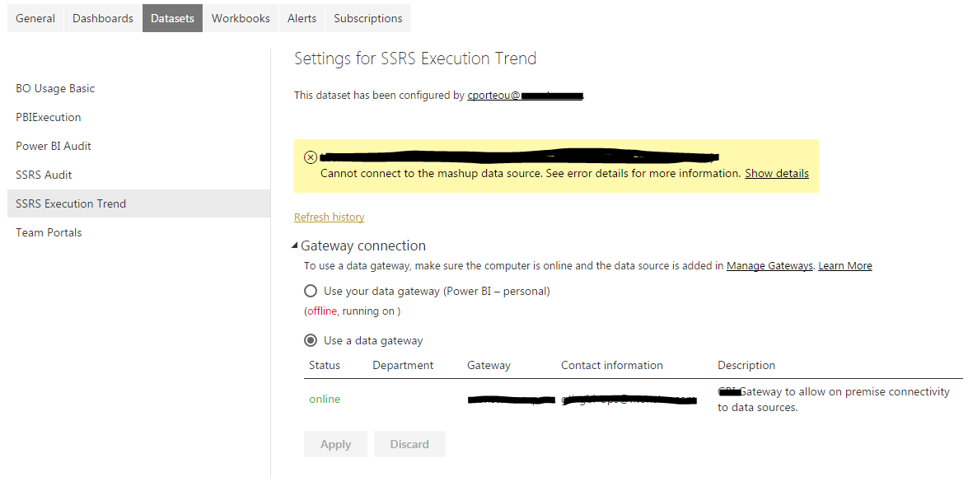
Data Sources
Data source naming is very specific.
A few examples…
ODBC connections have to match EXACTLY from local to the PowerBI Gateway name
SQL & SSAS connections have to be same DB
Use “master” and reference target DB name in queries when looking at several DBs on the same server.
You will be unable to select a managed Gateway connection for a dataset if these requirements are not met.

Slide 4
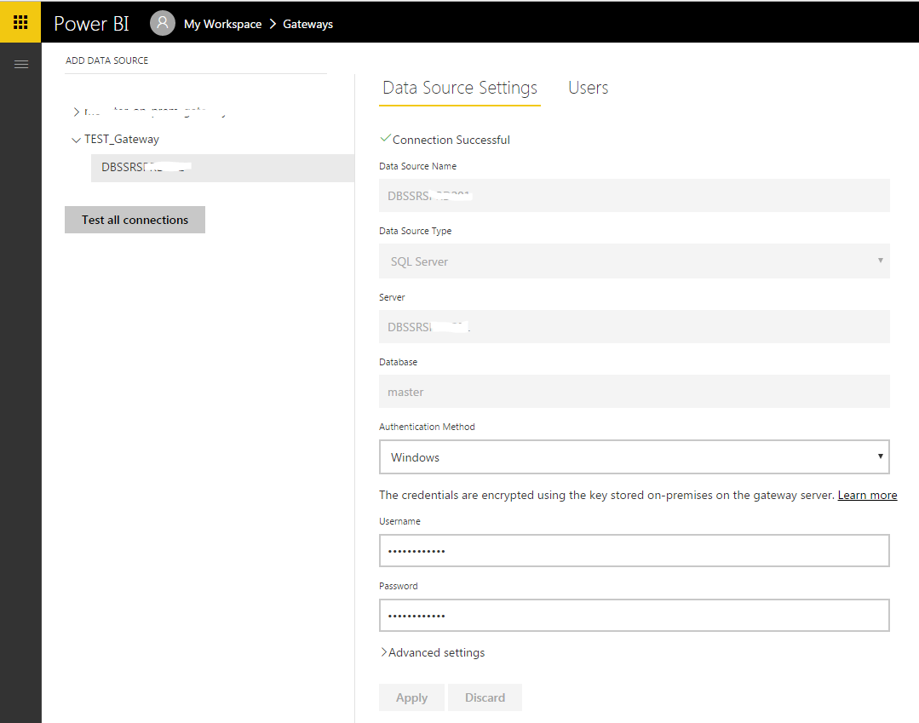

Slide 5
Data Sources
There is currently no direct way to connect to some cloud services from PowerBI such as an AWS MySQL database
We achieved this using ODBC connections on the Gateway server.
Performance implications?
It can also be achieved using MySQL as a datasource. Both methods require the data to go via the Gateway
This is still an “idea” under review: https://ideas.powerbi.com/forums/265200-power-bi-ideas/suggestions/6809030-aws-rds-sql-server-data-source
AWS MySQL Instance
MySQL Source
ODBC Connection

Slide 6
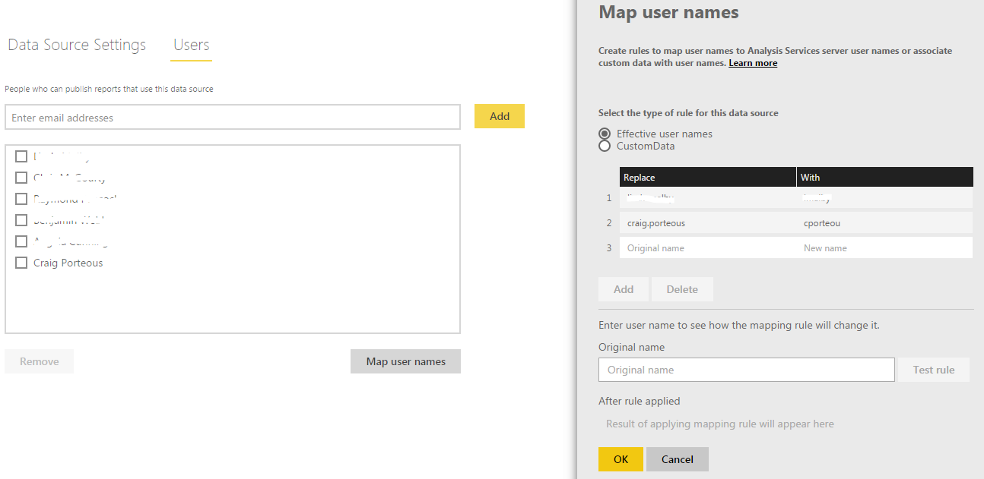
Authentication
SSAS Multidimensional & Tabular modes use “pass-through” authentication (like kerberos)
Issues with PowerBI user credentials & internal AD UPN. The Gateway passes EffectiveUserName
Manual substitution is possible (shown below) but tedious.
Consider AzureAD user account names before implementation.
Ie. If my UPN is Cporteou@Company.com. My PowerBI account should be the same, instead of registering with Craig.Porteous@company.com
SQL Server connections will connect using the stored credentials.
This is the same for all other connection types
Its also worth noting that both SSAS & SQL will require you to enter stored credentials! The gateway uses this to auth to SSAS then passes EffectiveUserName (must be an SSAS admin)

Slide 7
Disaster Recovery / High Availability
“High Availability
High availability options are in the roadmap for the gateway. Stay tuned for more updates.
”
Workaround involves 2 or more “Gateway servers” (or installations) on separate servers.
Switch between them using the Recovery Key provided during the original installation.
! You can only ever have one gateway server active at a time with a single recovery key !
There is no way to “scale out” or load balance the Enterprise Gateway though “load” is network based rather than CPU or Memory
https://powerbi.microsoft.com/en-us/documentation/powerbi-gateway-onprem-faq/#high-availabilitydisaster-recovery

Slide 8
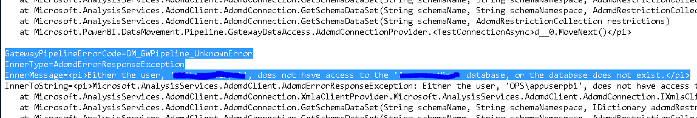
Monitoring & Diagnostics
There’s a good guide by Brett Powell on setting up a PowerBI report to monitor the On-premise Gateway using Perfmon:
https://insightsquest.com/2016/08/08/monitor-on-premises-data-gateways/
Gateway log directories:
Configuration Log Directory: C:\Users\cporteou\AppData\Local\Microsoft\On-premises data gateway
Gateway Service Log Directory: C:\Users\PBIEgwService\AppData\Local\Microsoft\On-premises data gateway
These logs will show errors for connections using this Gateway.
You could then use Powershell to pull these out & alert on them.
Ie.

Slide 9
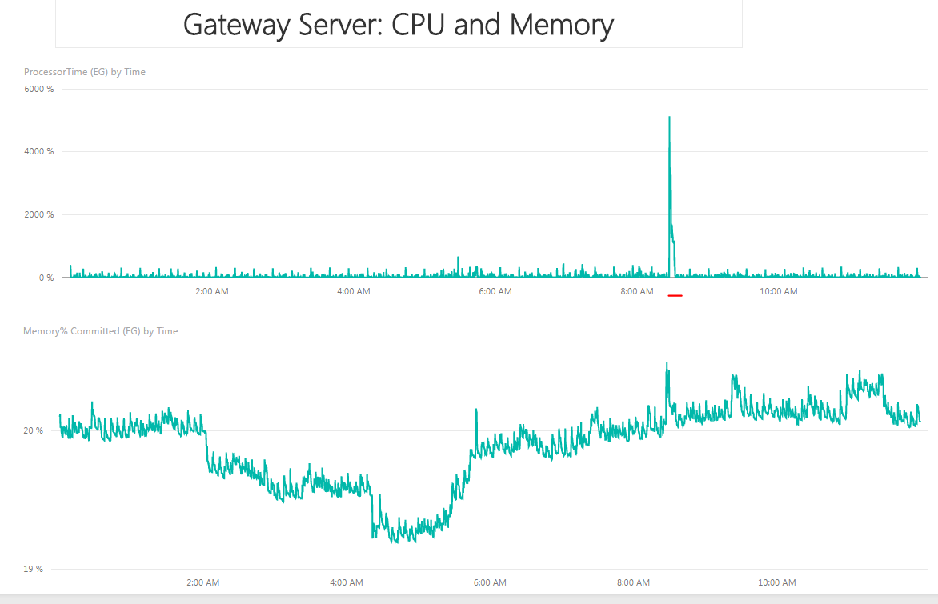
https://insightsquest.com/2016/08/08/monitor-on-premises-data-gateways/

Slide 10
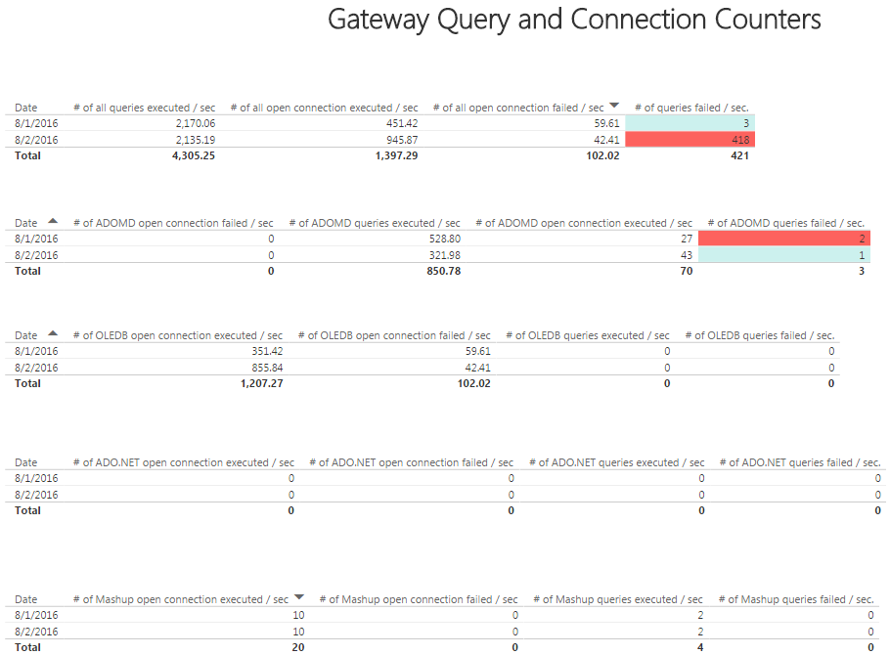
https://insightsquest.com/2016/08/08/monitor-on-premises-data-gateways/

Slide 11
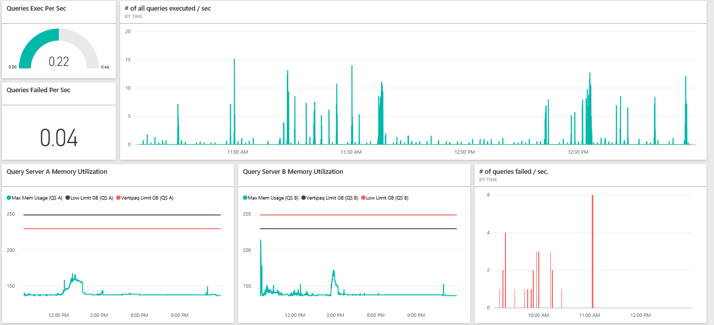
https://insightsquest.com/2016/08/08/monitor-on-premises-data-gateways/

